Slide 2
You HAVE to USE IT! It is not an OPTION!
There are 86400 sec in a day,
There are 1440 min in a day
There are 24 hours in a day
There is no Pauses, no Refund, no Returns or Bonus when it comes to TIME.
We all have equal amount of TIME regardless of FINANICAL OR SOCIAL STATUS.
It is LIMITED to our LIFESPAN!

Slide 4
Time Management is an Illusion Self Management is the FOCUS.

Slide 5
Concept of Significance Time

Slide 6
Time Management CALCULATION
Urgency: How SOON does it matters?
Importance: How MUCH does it matters?
Significance: How LONG is it going to matters?

Slide 7
Significance Calculations
You multiply your time by giving yourself the EMOTIONAL PERMISION to spend time on things TODAY that will give you more time TOMMORROW.
Notes:
This is how multipliers think

Slide 8
What I can do today that would make tomorrow better? What can I do right now that would make that future better?
Return on Time Invested ( ROTI )

Slide 9
How are we Using our TIME in MA?

Slide 11
7 Hours - Sleeping
1 Hour – Bathing, Grooming, Dressing, Etc…
8 Hours Total
8 Hours

Slide 12
2 Hours - Eating
1 Hour – Socializing
4 Hours Leisure
7 Hours Total
7 Hours
8 Hours

Slide 13
8 Hours – Job
1 Hour – Driving
9 Hours Total
9 Hours
7 Hours
8 Hours

Slide 14
24 HOURS
9 Hours
7 Hours
8 Hours

Slide 15
No Time Left for the Big things in Life!
Market America
Your Goals
Your Dreams
9 Hours
7 Hours
8 Hours

Slide 16
SIMPLE duplicatable task that can be REPEATED by a LARGE groups of people VS DIFFICULT task that can be REPEATED by a SMALL group of people

Slide 17
Simple Task
Duplicate
Repeat

Slide 18
Weekly Goal
Goal Staircase to $3600/week
Talked to 5-15 People
Booked 5 Appointments
Added 10 Possibilities
Daily Steps
UnFranchise Success Blue Print
5
4
3
Monthly Goal
2
EVERY DAY STEPS
Talked to 20-60 People
Booked 20 Appointments
Added 40 Possibilities
Social Media
Read Goal Statement
Listen to Audio
Talk/call to 1-3 People
Book 1 Appointment
Add 2 Possibilities
Goal Staircase to $3600/week
1
Weekly Steps
WEEKLY
GOAL
4
5
WEEKLY
GOAL
2
3
1
Week 4
4
5
WEEKLY
GOAL
2
3
EACH WEEK
Show Plan 2 times
Follow-Up with 1 Prospect
Attend UBP with guest
Add 1 New Customer
Call Your Coach
1
Week 3
4
5
3
2
Week 2
1
4
5
3
2
Week 1
1

Slide 19
Key Focus
RPA:
1 to 2 plan Weekly
1 product Weekly
1 Partner Stores a Week
Skill Set and mindset Development:
Coring
GMTSS
Audio
Reading
Stay the Course:
Reading Goals
Planning the week
Weekly Accountability
Keeping the Funnel Going:
Adding 2 name daily

Slide 21
A Calendar View
 | Monday | Tuesday | Wednesday | Thursday | Friday | Saturday | Sunday
6am - 7am
7am - 8am |  | S | L | E | E | P
8am - 9am
9am - 10 am
10am - 11am | W | W | W | W | W
11am - 12pm | O | O | O | O | O
12pm - 1pm | R | R | R | R | R
1pm - 2pm | K | K | K | K | K
2pm - 3pm
3pm - 4pm
4pm - 5pm
5pm - 6pm
6pm - 7pm
7pm - 8pm | CORING |  |  | HBP
8pm - 9pm |  | PRD CALL
9pm - 10pm
10pm - 11pm
11pm - 12am |  | S | L | E | E | P

Slide 22
Time Management : Sit Down Meeting ( 1 on 1/ 2 on 1)
Time Management: Using Events
Task Share business: 2 hrs – sit down meeting 1 Prospect
Share Products : 1 hrs – sit down Meeting 1 Prospect
Tickets : Bought 1
Duplicate/Delegate – 10 UFO
Share business: 20 hrs – sit down meeting 10 Prospect
Share Products : 10 hrs – sit down Meeting 10 Prospect
Tickets : Bought 10
Total Exposure:
Business: 10 Product: 10
Leverage Time Per GMTSS LOCAL : 10x8hr = 80 hrs
Task Share business: 2 hrs – HBP (5 Prospect)
Share Products : 1 hrs – PRODUCT EVENTS (5 Prospect)
Tickets : Bought 3
Duplicate/Delegate – 10 UFO
Share business: 20 hrs – HBP – 50 Prospect
Share Products : 10 hrs – PRD Event – 50 Prospect
Tickets : Bought 30
Total Exposure:
Business: 50 Product: 50
Leverage Time Per GMTSS LOCAL : 30x8hr = 240 hrs

Slide 23
Time Management : Sit Down Meeting ( 1 on 1/ 2 on 1)
Time Management: Using Events
Growth Factor ( 10 – 4 – 1) 1st Quarter: 10 UFO
Share business: 2 hrs – sit down meeting 10 Prospect TIME SPEND: 20hrs
Share Products : 1 hrs – sit down Meeting 10 Prospect TIME SPEND: 10hrs
Tickets : Bought 10
YOU PUT IN 3 HRs
2nd Quarter : 11UFO ( New Sponsor: 1)
Share business: 2 hrs – sit down meeting 11 Prospect :22 hrs
Share Products : 1 hrs – sit down Meeting 11 Prospect : 11 hrs
Tickets : Bought 1 = 11 Tickets YOU PUT IN 3 HRs
3rd Quarter : 12 UFO ( New Sponsor: 1)
Share business: 2 hrs – sit down meeting 12 Prospect :24 hrs
Share Products : 1 hrs – sit down Meeting 12 Prospect : 12 hrs
Tickets : Bought 1 = 12 Tickets YOU PUT IN 3 HRs
4th Quarter : 13 UFO ( New Sponsor: 1)
Share business: 2 hrs – sit down meeting 13 Prospect :24 hrs
Share Products : 1 hrs – sit down Meeting 13 Prospect : 12 hrs
Tickets : Bought 1 = 13 Tickets YOU PUT IN 3 HRs
Leverage Time Per GMTSS LOCAL : 13x8hr = 104 hrs
Tickets 10
Growth Factor ( 10 – 4 – 1) 1st Quarter: 10 UFO
Share business: 2 hrs – HBP: 50 Prospect : 20 hrs
Share Products : 1 hrs – Product 50 Prospect: 10rs
Tickets : Bought 30 YOU PUT IN 3 HRs
2nd Quarter 2: 15 UFO ( New Sponsor: 5)
Share business: 2 hrs – HBP: 75 Prospect : 30hr
Share Products : 1 hrs – Product 75 Prospect:15 hrs
Tickets : Bought 1 = 45 Tickets YOU PUT IN 3 HRs
3rd Quarter : 22 UFO ( New Sponsor: 7)
Share business: 2 hrs – HBP :110 Prospect: 44 hr
Share Products : 1 hrs – Ptoduct: 110 Prospect 22 hrs
Tickets : Bought 1 = 66 Tickets YOU PUT IN 3 HRs
4th Quarter : 33 UFO ( New Sponsor: 11)
Share business: 2 hrs – HBP: 165 Prospect: 66 Hrs
Share Products : 1 hrs – Product: 165 Prospect: 33 hrs
Tickets : Bought 1 = 99 Tickets
YOU PUT IN 3 HRs
Leverage Time Per GMTSS LOCAL : 33x8hr = 792 hrs
Tickets 99

Slide 24
Pitfalls
Work Hard they don’t work smart
I can achieve my goals on what I feel like doing
EGO – Me Me Me
Skillset
Not being able to identify sit down meet time vs social time
Scheduling: not logging and no calendar
Talking too much or taking too long on the appointment
Bundle Time
Social: Where business and social combine
Leverage: Learning to work your legs
Focus on anything but what you need to do
No Planning

Slide 25
Team Culture
Weekly Coring – Personal & Team Development – 2 hrs
TEAM Weekly HBP – Leverage Time RPA – 2hrs
Product Call – Helps 1 hr weekly Customers/UFO Management
We have 3 to 5 hrs a weekly left

Slide 27
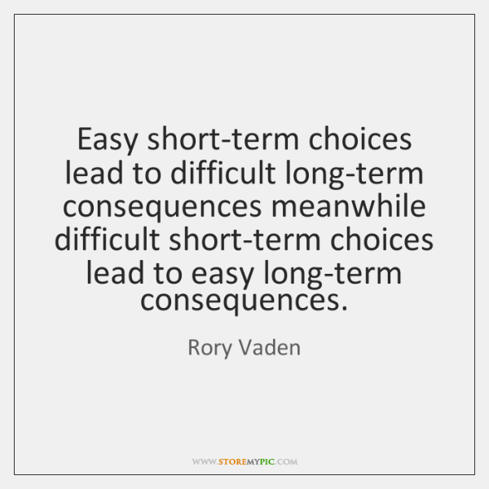

Slide 28
Have a mindset of a Successful Entrepreneur. Time is valued more then Money. Handle time with the Significance Approach!

